Slide 1
Mushroom Classification
Presented by:
Rehab Alaswad
Jeza Allohibi

Slide 2
Outline
Introduction
Data Preprocessing
EDA
Machine Learning Models
Model Evaluation
Results and Conclusion

Slide 3
Introduction
In this project we will dive into mushroom classification problem which is represented by a tabular dataset that contains 23 features and 8124 observations, labeled as edible or poisonous mushroom
The goal is to classify mushrooms as either edible or poisonous.

Slide 4
Import resources
We imported the needed resources and configurations to the environment.
Pandas
Numpy
Matplotlib,seaborn
scikit-learn for preprocessing,
Notes:
Pandas will be used for data manipulation,
Numpy for linear algebric operations such as converting data shape into an array.
Matplotlib,seaborn for visualizations,
scikit-learn for preprocessing,

Slide 5
Data set
This dataset is collected from the archive of University of California, Irvine, This dataset originally created by University of Wisconsin Clinical Sciences Center, and titled as Breast Cancer Wisconsin (Diagnostic)
Data Set, according to Kaggle.com/ this dataset was updated 3 years ago.

Slide 6
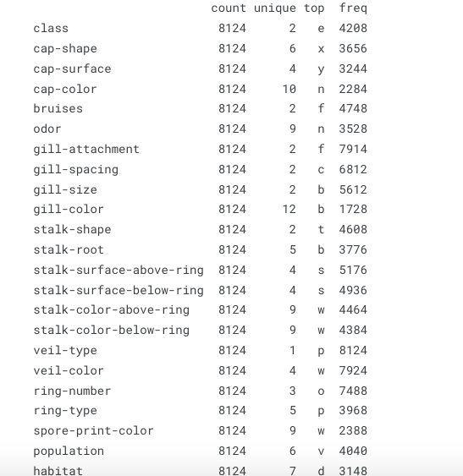
Statical summary
Here we observe the distribution of our data and how values are distributed among the columns.
Notes:
exploratory data analysis which will performed by going through investigating features to see how data is distributed, unique values, and if there are any missings values.
From the first 5 entries for each column,
it can be seen that all our categorical and a total of 8124 rows.
the feature 'veil-type' has only have one unique observation, which does not add any value to our analysis, therefore we will eliminate it.

Slide 7
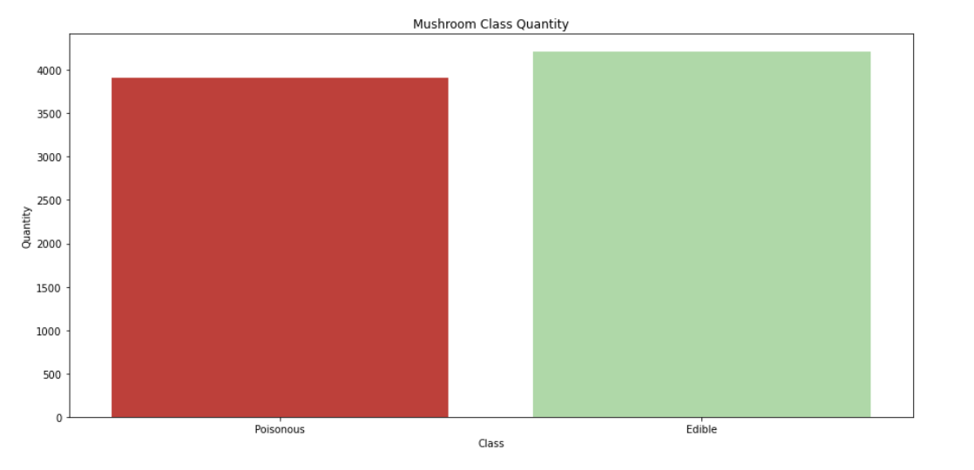
Notes:
The distribution of the 'class' feature is balanced and not distributed extremely in p or e label.

Slide 8
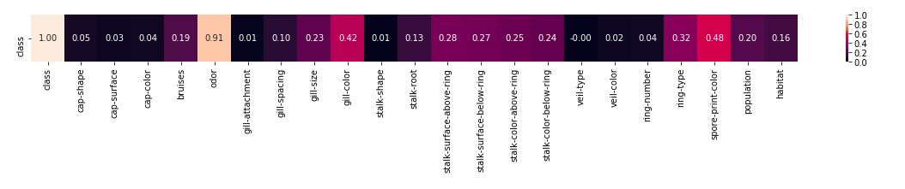
Uncertainty Coefficient
Notes:
the Uncertainty Coefficient. Formally marked as U(x|y), this coefficient provides value in the range of [0,1], where 0 means that feature y provides no information about feature x, and 1 means that feature y provides full information about features x's value.
Findings:
It can be seen how insignificant feature is 'veil-type' to target feature 'class', which needs to be removed from dataset.
The feature odor is the most significant one for target feature

Slide 9
Feature engineering
One –hot label encoding
is a technique which applied mostly for text-based categorical data, to transfer the values into boolean numerics of 1s or 0s, and each label will be added as a column and every time it occurs as a label it will get 1 as a value if exist, otherwise will get 0.
Notes:
In the feature engineering step, Data will be transformed into an acceptable format for machine learning models.
Since all our features are all categorical, we will need to encode them to numerical values.

Slide 10
Building ,Training, and Testing machine learning models
Building a machine learning model will start first by setting the train/test data split, then build and evaluate several models and summaries each model score.
Data train/split is the main step into test machine learning on unseen data, Here train/test data split by a 80:20 ratio, which means that models will be trained by 80% of data, and tested on 20% of unseen data.

Slide 11
classification methods
Different classification methods are used in predicting whether the mushrooms are edible or poisonous
Random forest
Decision tree
Logistic regression
KNN

Slide 12
Random forest
Random forest is a Supervised Machine Learning Algorithm that is used widely in Classification and Regression problems.
Random forests are a strong modeling technique and much more robust than a single decision tree. They aggregate many decision trees to limit overfitting as well as error due to bias and therefore yield useful results.
Test Accuracy :100 %
Notes:
Random forest :
Decision tree:

Slide 13
Decision tree
A decision tree is a non-parametric supervised learning algorithm, which is utilized for both classification and regression tasks. It has a hierarchical, tree structure, which consists of a root node, branches, internal nodes and leaf nodes.
The goal of using a Decision Tree is to create a training model that can use to predict the class or value of the target variable by learning simple decision rules inferred from prior data(training data). In Decision Trees, for predicting a class label for a record we start from the root of the tree
Test Accuracy :99.88%

Slide 14
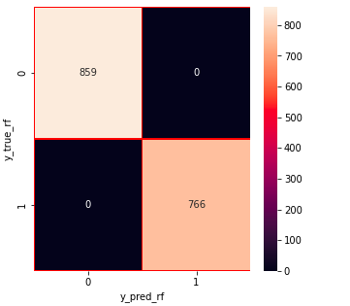
Confusion matrix
Notes:
With confusion matrix we saw that our train and test datas balanced, so there is no problem in there.

Slide 15
Logistic regression
Logistic regression estimates the probability of an event occurring, such as voted or didn’t vote.
Logistic regression is used when the dependent variable(target) is categorical.
In logistic regression, we decide a probability threshold. If the probability of a particular element is higher than the probability threshold then we classify that element in one group or vice versa.
Notes:
Random forest :
Decision tree:

Slide 16
K-Nearest Neighbors algorithm
The k-nearest neighbors algorithm is a non-parametric, supervised learning classifier, which uses proximity to make classifications or predictions.
For classification problems, a class label is assigned based on a majority vote—i.e. the label that is most frequently represented around a given data point is used.
To determine which data points are closest to a given query point, the distance between the query point and the other data points will need to be calculated.

Slide 17
KNN
Define loss function
Create 10-fold CV object
Create grid of hyperparameter values
Tune a KNN model using a grid search
Best model's k value
Build KNN on the best k value and make the prediction & accuracy

Slide 18
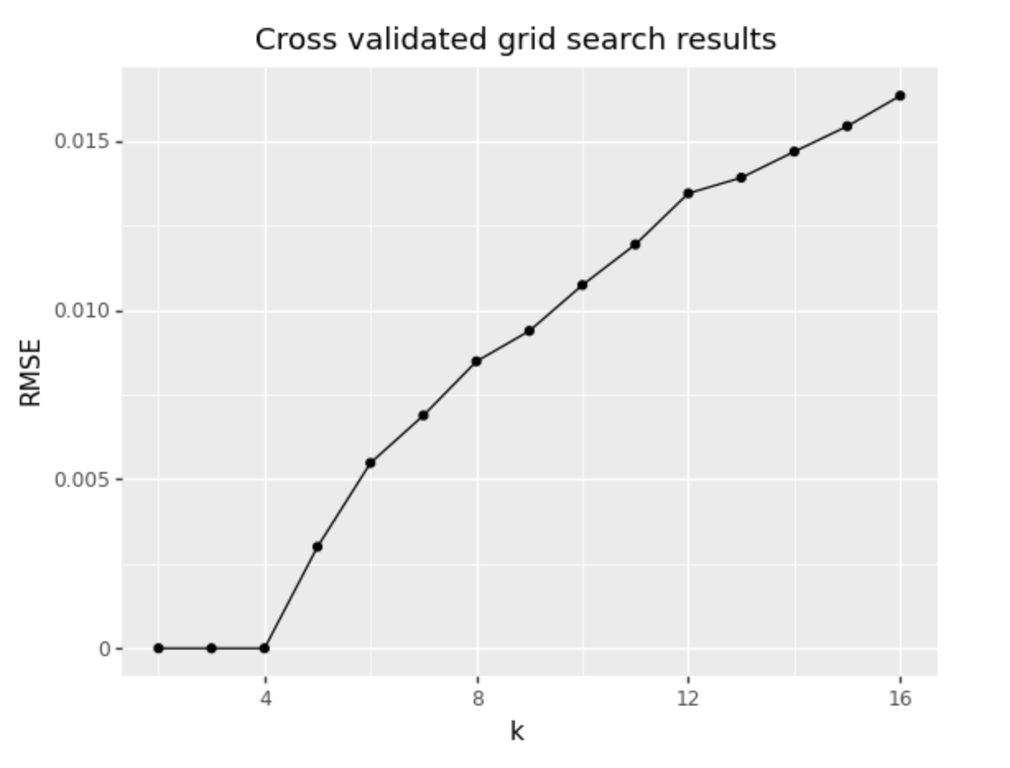

Slide 19
The outputs of machine learning models using the One Hot Encoding technique and an 80/20 split strategy
We were able to predict with perfect accuracy the poisonous and edible mushrooms with Random forest , and logistic regression , and very high accuracy in KNN and decision tree.
Classification model | Accuracy
KNN | 99.88 %
Logistic regression | 100 %
Random forest | 100 %
Decision tree | 99.88%

Slide 20
Conclusion
We were able to predict with very high accuracy the poisonous and edible mushrooms with Random forest , and logistic regression .

